Slide 1
Data Distribution Metadata Application
Tryouts and Prototyping with Informatica EDC
September 2020

Slide 2

Solution Overview
Metadata Provider
Provide JSON file
Data Distribution Metadata Application
Informatica EDC
for Risk
Metadata Interfaces
Metadata Utilities
Metadata Registry
Metadata Insight
Changes over time
Lineage
Quality insight
Store versioned metadata entities
Conversions
APIs
JSON file based
load
2020
Lineage Visualization
2021

Slide 3
Tryout
Goal: Check if lineage can be provided to EDC by means of API calls.
Re-use: Use the EDC Database scanner to load the table structure into EDC

Slide 4
Tryout - description
Create demoSource and demoTarget tables in SQLServer
Create connections to demoSource and demoTarget in EDC
Invoke EDC’s database scanner for demoSource and demoTarget
Result: The table definitions are in EDC, but not lineage
Call EDC API to create lineage between the tables demoSource and demoTarget
Call EDC API to create lineage between one table column in demoSource and demoTarget

Slide 5
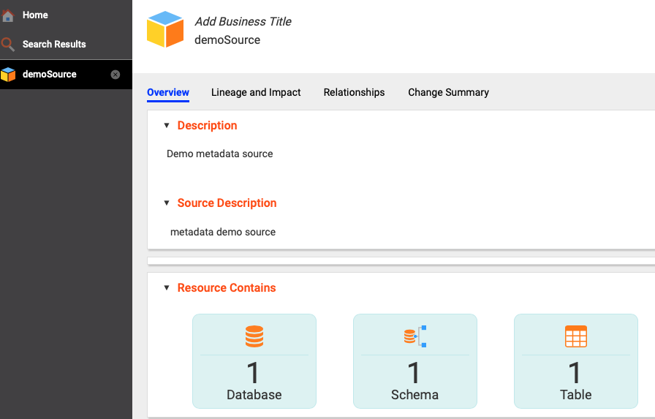
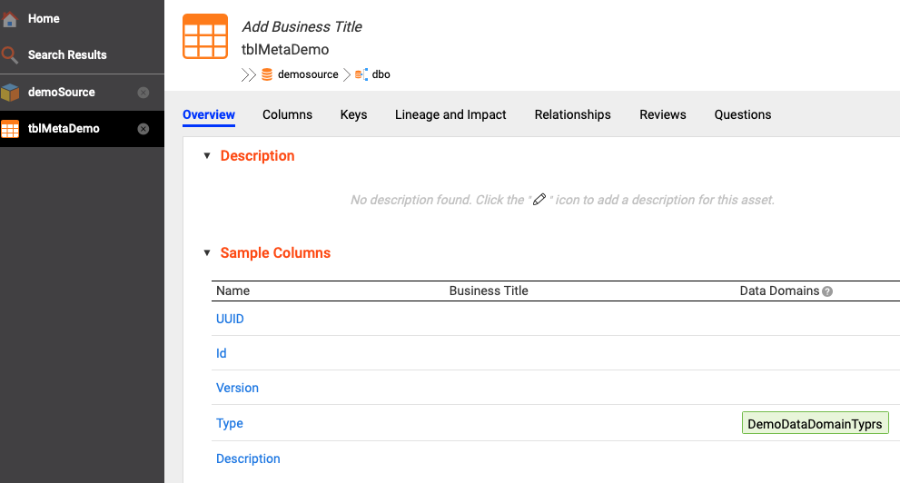
Tryout – Result after database scan

Slide 6
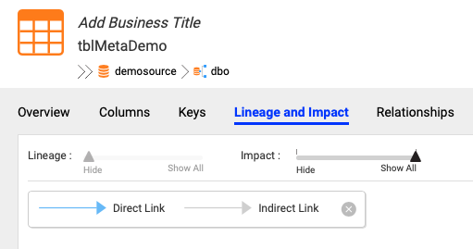
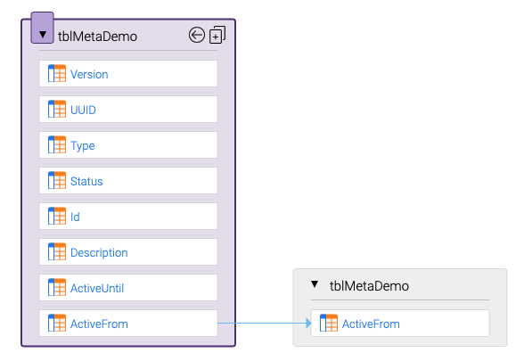
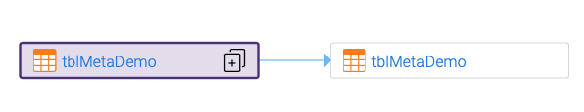
Tryout – Result after calling lineage API
Note: In this prototype the API was only called for the column “ActiveFrom”
(to do this for all columns had not yet been implemented)
After clicking the + symbol, the column lineage is shown

Slide 7

Tryout Outcome

Slide 8

Prototype 1
Planned for September 2020
Goal: Check if lineage for database tables can be provided to EDC by means of API calls using Python code
Re-use: Use the EDC Database scanner to load the table structure into EDC

Slide 9
Prototype 2
Planned for September 2020
Goal: Check if lineage for files can be provided to EDC by means of API calls using Python code
Re-use: Use the EDC Azure Blob Storage scanner to file structure into EDC

